Slide 1


Machine Learning
With python
MOD1: MORE MODELS
KNN, PCA, Logistic Regression
Notes:
Layout objects pulled from: https://slidesgo.com/
All icons are from: https://thenounproject.com/

Slide 2
Colab workbook
Link: click for access

Slide 3
KNN
Supervised classification algorithm often referred to as a lazy learner as it seeks to predict without creating an actual model
Important hyperparameters
Number of neighbors n_neighbors: controls how many nearest points are used for classification. Larger k, smoother boundary, risk underfitting
Distance metric metric can be Euclidean (default, straight-line), Manhattan (grid), or Minkowski (generalized form)
Weighting of neighbors weights: can be uniform, or distance (closer = more influence)
Pros: no need to preprocess since it does it on the fly. Interpretable.
Cons: computational cost, scaling, choosing the right k

Slide 4
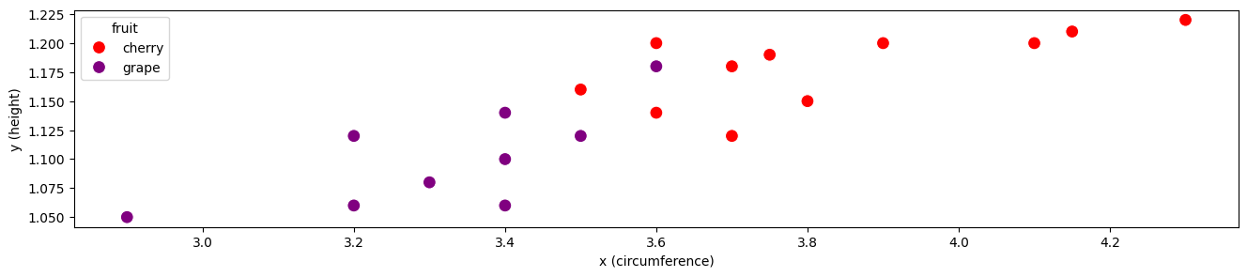
Assumes observations that are close to each other have similar properties using some distance metric. The majority class in the neighborhood is what we classify the new point as.
KNN
For this algorithm,
We pick a number k
In order to classify a point P , we look at the k data points which are closest to P
These k data points “vote” on what they think P should be, and the majority wins
Let k = 5
P
majority purple, so point P is classified as purple

Slide 5
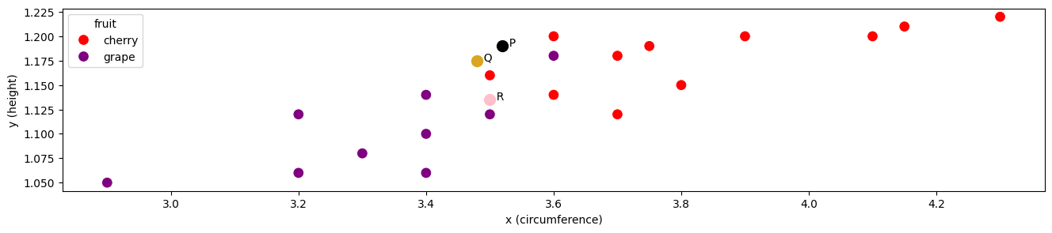

warmup
For each of the points below:
Which 3 data points are closest? Are they majority grapes or cherries?
Based on those three neighbors, would you classify the point as a grape or a cherry?
P: cherry
Q: grape
R: both?

Slide 6
Shading in the region that would be classified as cherries using the 3-nearest neighbors
Point R could be both since it’s on the decision boundary.
If this happens, usually will get classes the same as it’s 1-closest neighbor

Slide 7

Exercise
Suppose instead of using the 3 nearest neighbors, we use a different k. For each k:
Describe what would happen to the region that would be shaded to classify cherries.
Would this be better or worse than 3-NN? Explain
1. k = 1 2. k = 20

Slide 8

How to choose the best k?
Use the ML workflow!
Tune your parameter by choose a range of k values and building models for each
Implement cross-fold validation to get an average evaluation metric for each value of k
Choose k that performs the best on average.
Usually in classification problems (especially when binary) we tend to pick odd values for k.
Using what you know about k-NN:
When would even values for k cause issues?
What could you do to fix this issue?
breaking ties
closest neighbor gets deciding vote
weigh “vote” by closeness

Slide 9
How to choose the best k?
Use the ML workflow!
Tune your parameter by choose a range of k values and building models for each
Implement cross-fold validation to get an average evaluation metric for each value of k
Choose k that performs the best on average.
If you have 10 values for k, and do 5-fold cross validation:
How many models are you running in total?
How many evaluation metrics are you comparing when selecting which k is best?
50 total models: 10 values for k, each do 5-fold CV
10 metrics: one average metric for each value of k

Slide 10
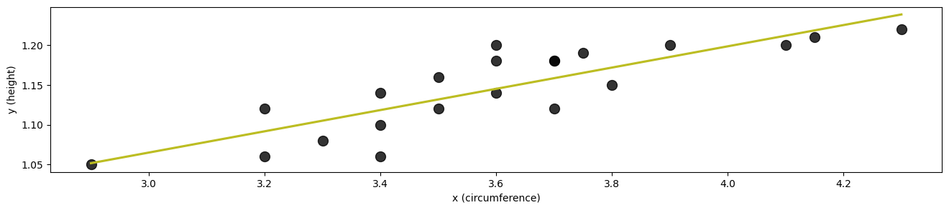
Exercise
Which direction has the biggest variance?

Slide 11
PCA with 2 components
least variance
most variance
PC1 would be where most variance occurs, PC2 covering the rest.
Likely PC1 will look similar (but not the same) to the green regression line. This is because x and y equally contribute to the variance and therefore PCA1

Slide 12
PCA
Unsupervised dimension reduction algorithm that finds directions (components) in which the data has the most variation
Principal components are linear combinations of the original features.
Original features may be lost in the transformed space, so may lose some interpretability
Pros: detects outliers, visualization, faster algorithms
Cons: model performance (slows training, speeds up testing, so tradeoff)

Slide 13
How does PCA find most important components?
Caveats
Features with different scales mess this up, since feature with biggest spread would dominate
Standardize first, so mean at 0 and s.d is 1.
Start with a line: ax1 + bx2 + c = 0
Look at the data projected onto the line (lots of linear algebra)
Find a,b,c that maximize variance of the projected data

Slide 14
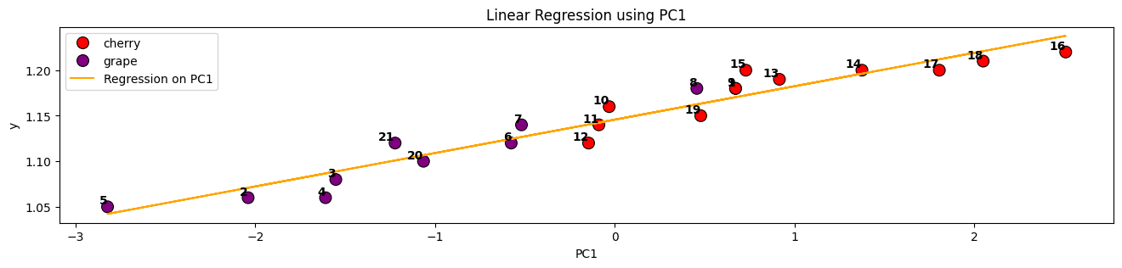
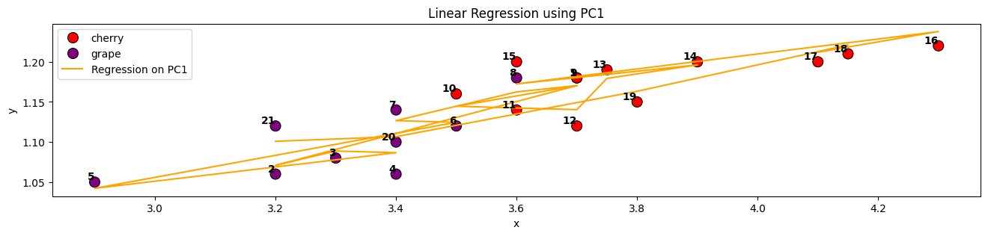
PCA with 1 component, used in simple linear regression to create orange line
Note: PCA distorts original space, so interpretation can be difficult. Top plot uses PC1 for horizontal axis, whereas bottom plot using original x feature

Slide 15
Logistic regression
Supervised classification algorithm that predicts the probability of a class using the sigmoid function
Important hyperparameters
Regularization Strength C controls how much the model penalizes large coefficients. The higher the C, less regularization, risk of overfitting.
Regularization Type Penalty can be L1 (Lasso), L2 (Ridge), or ElasticNet (L1 +L2 combo).
Pros: interpretable, memory efficient (may need stochastic gradient descent if data too large)
Cons: similar to linear regression, multicollinearity (related features), outliers, non-linear

Slide 16
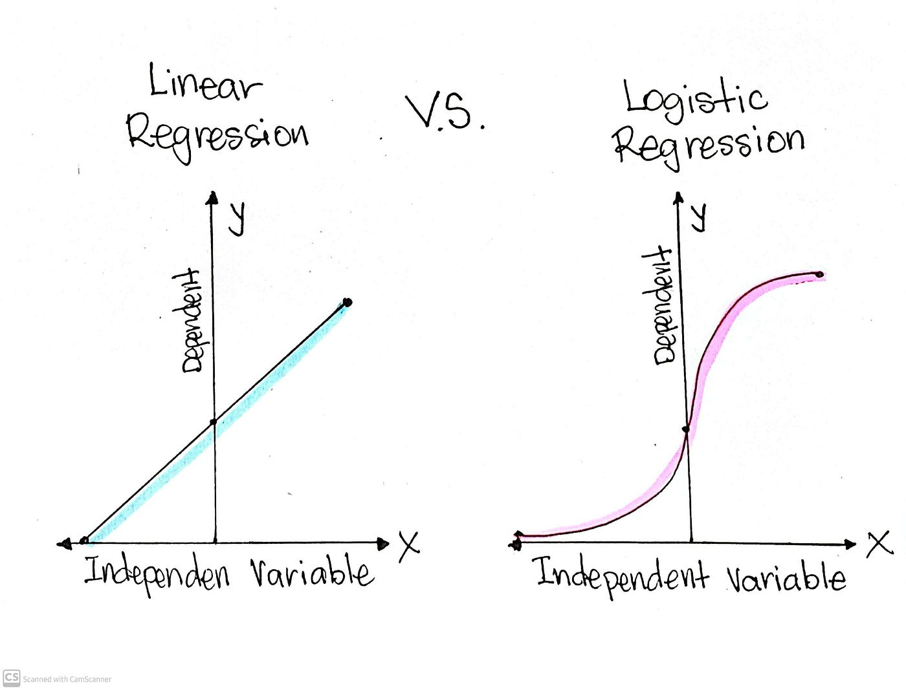
Logistic regression
Similar to linear regression since it uses gradient descent but with few changes:
Instead of a straight-line equation, it uses a probabilistic equation
Instead of MSE it uses log-loss
After probability outputted, it “squished” it towards 0 or 1 using a function (usually sigmoid)
So it uses gradient descent but with a different cost function

Slide 17
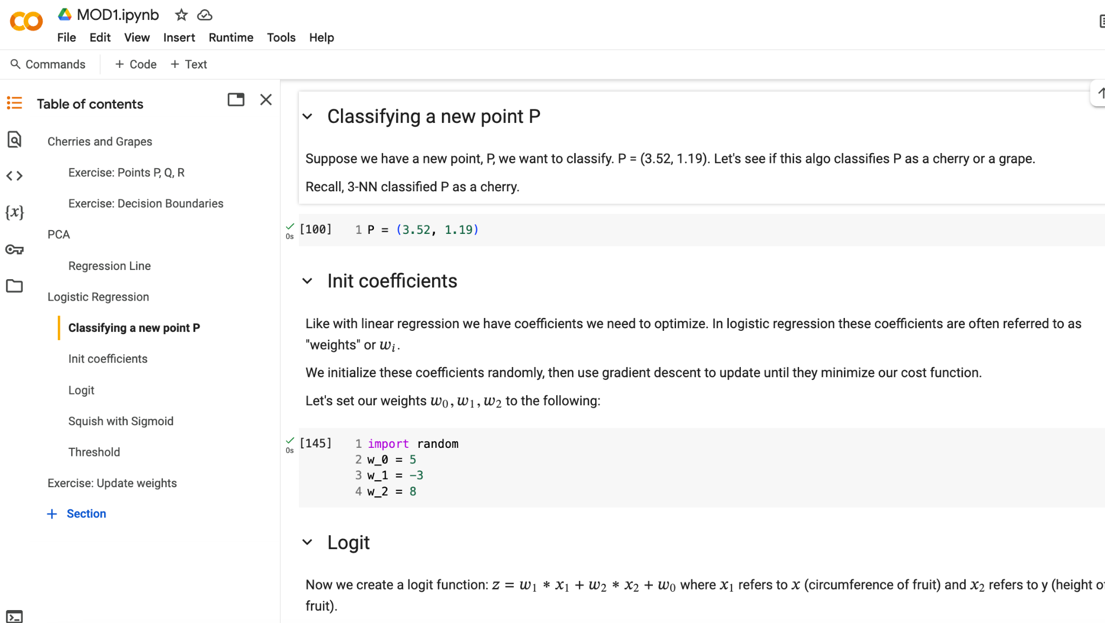

Slide 18
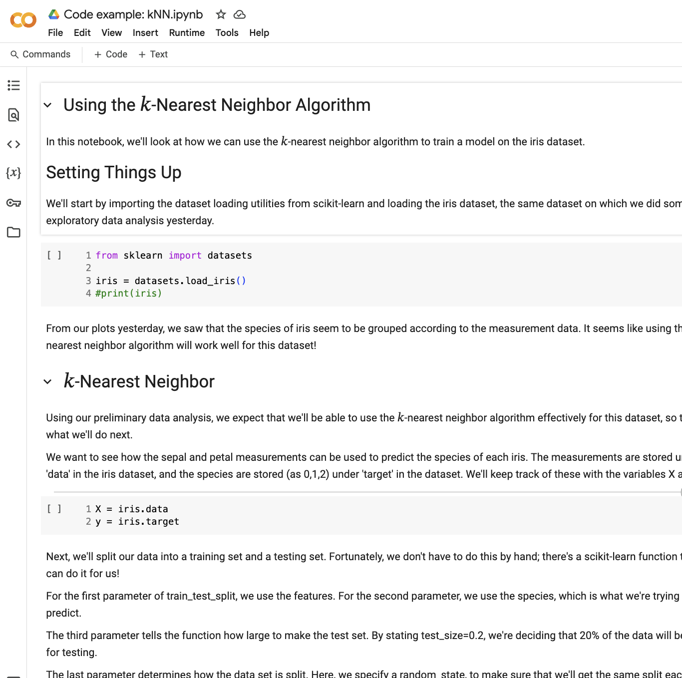
Example of how the KNN algorithm works:
click link here
Go through this to solidify your understanding.

Slide 19
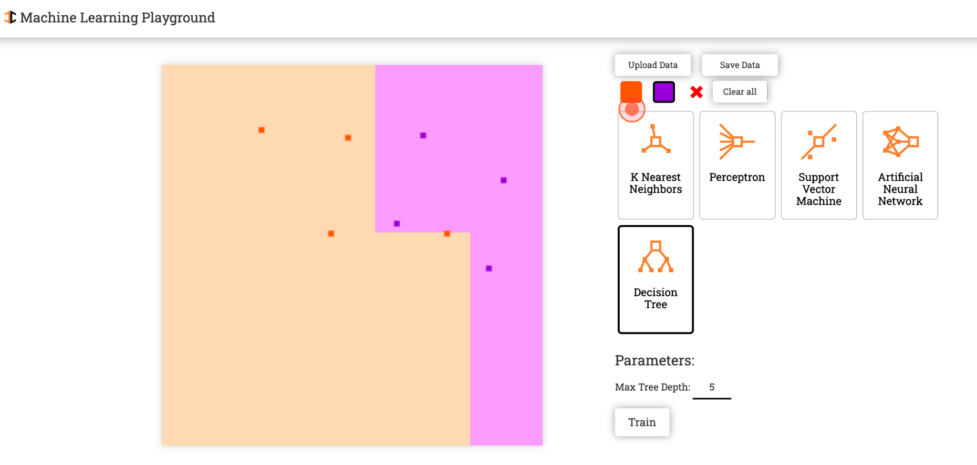
https://ml-playground.com/#

Slide 20
Machine Learning
With python
MOD2: MORE MODELS
SVM, Naive Bayes
Notes:
Layout objects pulled from: https://slidesgo.com/
All icons are from: https://thenounproject.com/

Slide 21
Colab workbook
Link: click for access

Slide 22
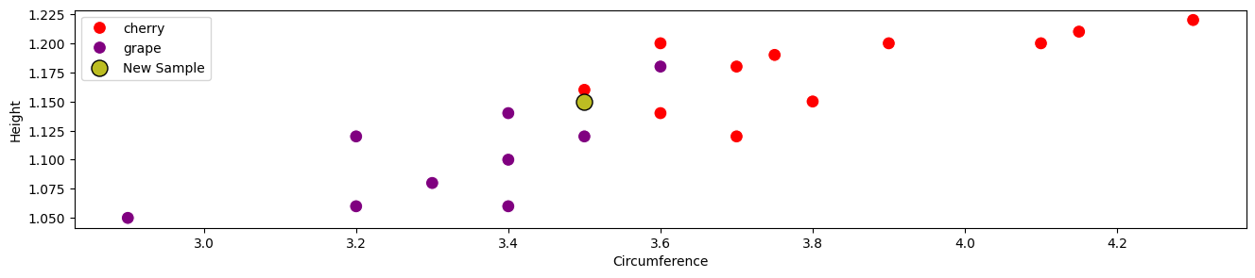
Exercise
Do you think the new sample (green) is more likely to be cherry or grape? Is it a close call? Guess the likelihood of it being either of the classes.

Slide 23
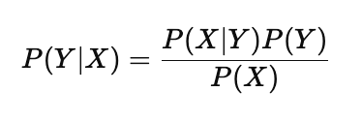
NAive Bayes
Based on Bayes' theorem which assumes feature independence. It predicts the probability of a class given the input features. So if we use feature set to predict target, we want to quantify the odds that our prediction is the actual value.
Relies on independence of features, hence why it’s called naive (features are rarely independent).
You also need to specify a probability density function (like normal/Gaussian, binomial/Bernoulli, etc) for likelihood
likelihood
prior
posterior
evidence
where Y is the class label
and X are the features

Slide 24
Naive Bayes
Supervised classification algorithm that predicts the probability of a class using Bayes theorem
Important hyperparameters
Variance Smoothing var_smoothing adds small buffer to variance so no division by zero. The higher the var_smoothing, smoother decision boundary, prevents overfitting.
The others depend on which distribution you use
Pros: fast and memory-efficient, handles missing data, high-dim small data
Cons: poor performance on highly correlated features (multicollinearity), sensitive to zero probabilities (needs smoothing)

Slide 25
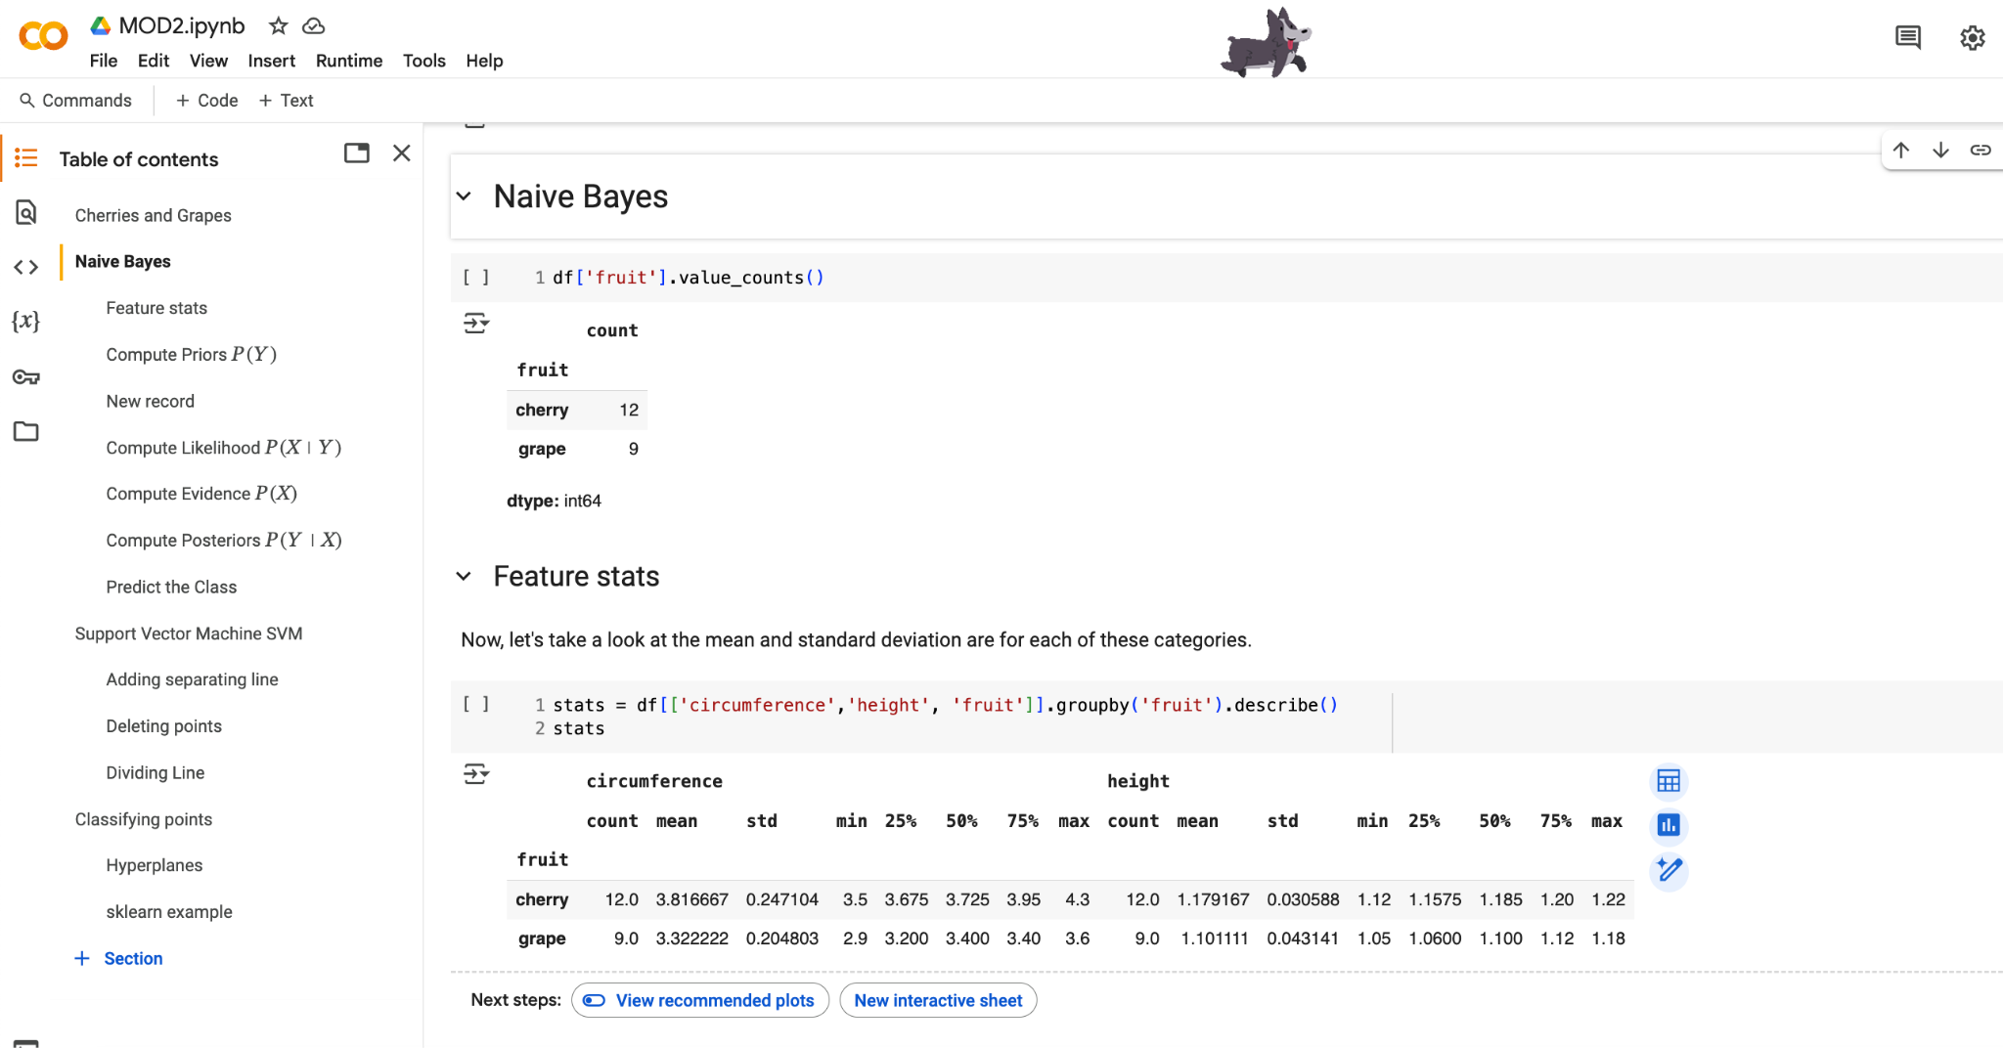
walk through the calculations in workbook

Slide 26
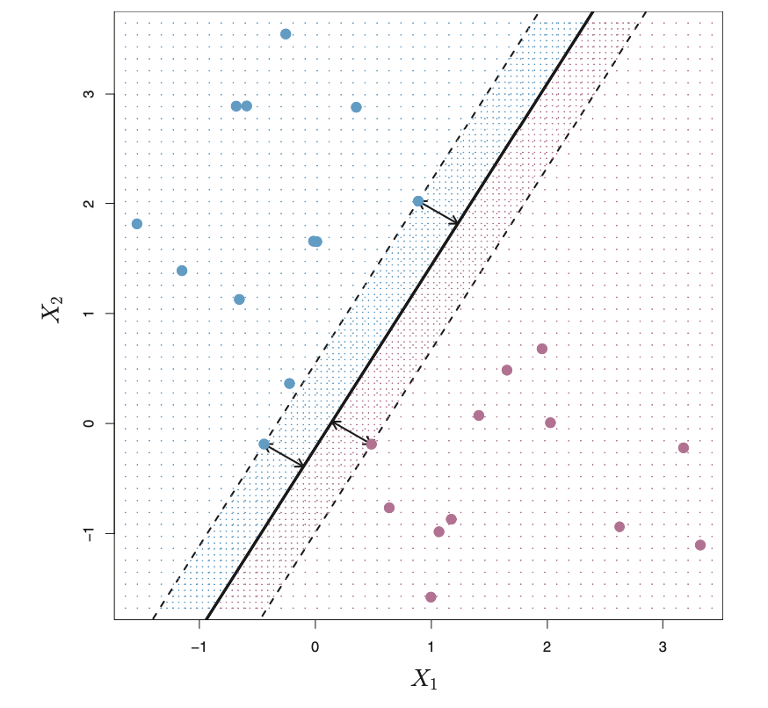
support vector machine svm

Slide 27
svm
Supervised classification algorithm that finds the optimal decision boundary (hyperplane) that maximizes the margin between classes.
Important hyperparameters
Regularization Strength C controls how much the model penalizes large coefficients. The higher the C, less regularization, risk of overfitting.
kernel defines the type of decision boundary. Can be linear, polynomial, sigmoid.
Pros: high-dimensional data,linear and non-linear, robust to outliers (with soft margin).
Cons: computationally expenses, hyperparameter sensitive, highly overlapping classes

Slide 28
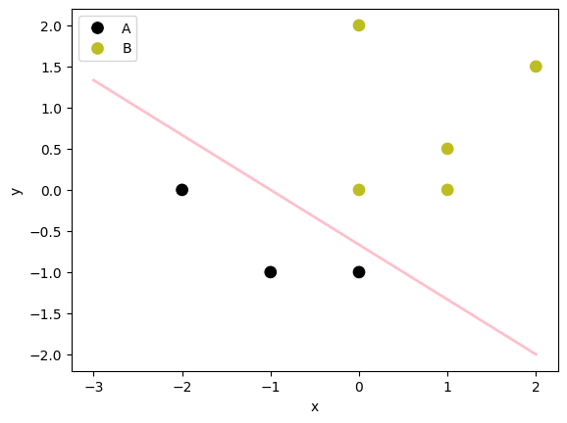
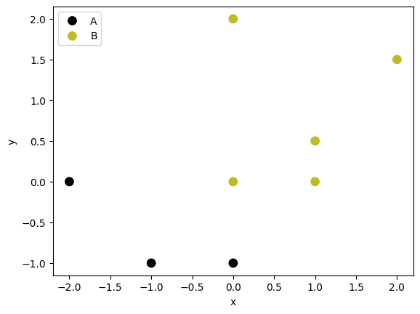
Exercise
What line best separates these two classes, A (black) and B (green)?
Under the SVM section in colab go to Adding a separating line. Use the add_line function to add a line to this graph that best separates the classes.
Does the line that the person sitting next to you look better than yours? How can you tell which line is the best separating line?

Slide 29
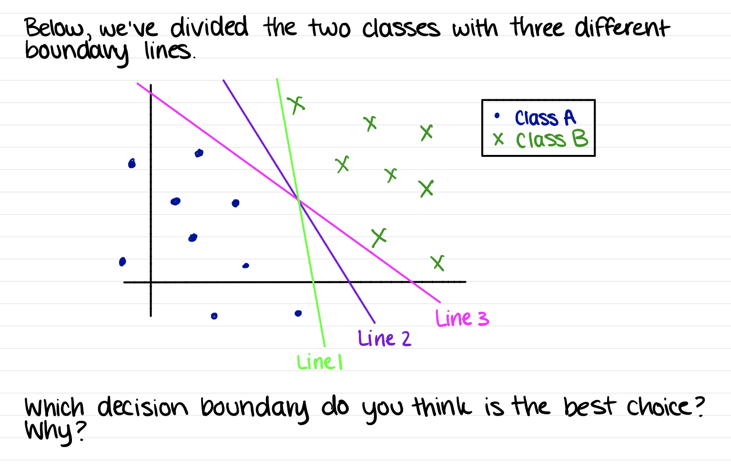

Slide 30
Exercise
Now, let’s delete some points! For the following points, describe if your separating line would change if these points were deleted.
black (-1,-1)
green (1,0.5)
black(-2,0)
green (0,0)
Any points that matter the most will affect the separating line. These are called the support vectors.

Slide 31
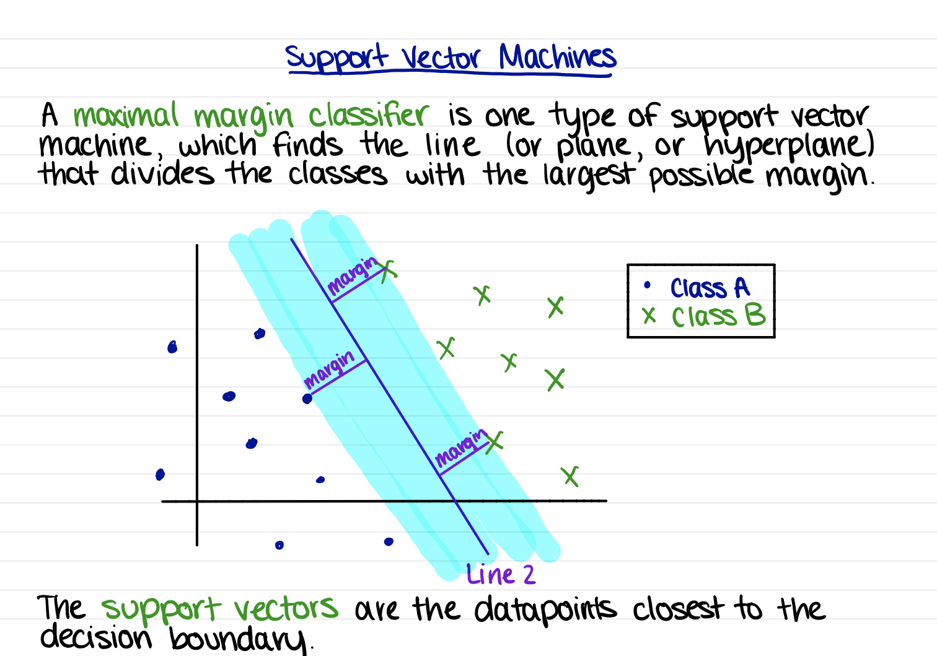

Slide 32
Exercise
Follow these steps to find 𝑓(𝑥1,𝑥2 )
Write down the equation of your line you found in the form: 𝑦 = 𝑚𝑥+𝑏
Change the 𝑥 to an 𝑥1 and the 𝑦 to 𝑥2
Subtract everything over to the right side of the equation, so the left side is just 0. The function 𝑓 is defined by the right side of the equation you wrote. In other words, you've just written what 𝑓(𝑥1,𝑥2) is.
The dividing line should be the set of points (𝑥1,𝑥2) such that 𝑓(𝑥1,𝑥2)=0 . This is ideal since the two sides can be denoted where 𝑓 is positive and 𝑓 is negative. In other words, 𝑓(𝑥1,𝑥2)>0 and 𝑓(𝑥1,𝑥2)<0 will distinguish our two categories.

Slide 33
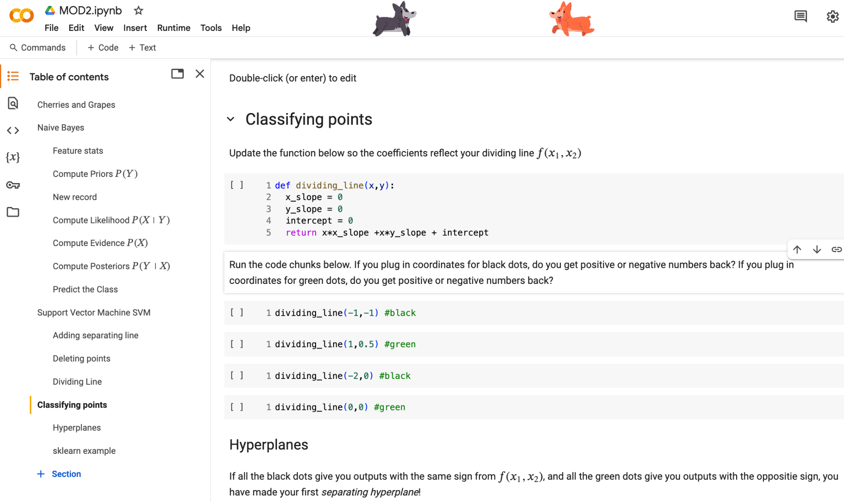
The dividing line should be the set of points (𝑥1,𝑥2) such that 𝑓(𝑥1,𝑥2)=0 . This is ideal since the two sides can be denoted where 𝑓 is positive and 𝑓 is negative. In other words, 𝑓(𝑥1,𝑥2)>0 and 𝑓(𝑥1,𝑥2)<0 will distinguish our two categories.

Slide 34
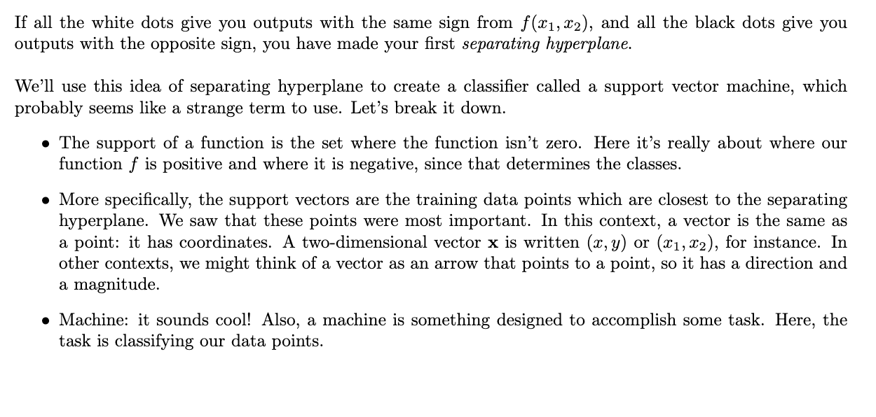

Slide 35
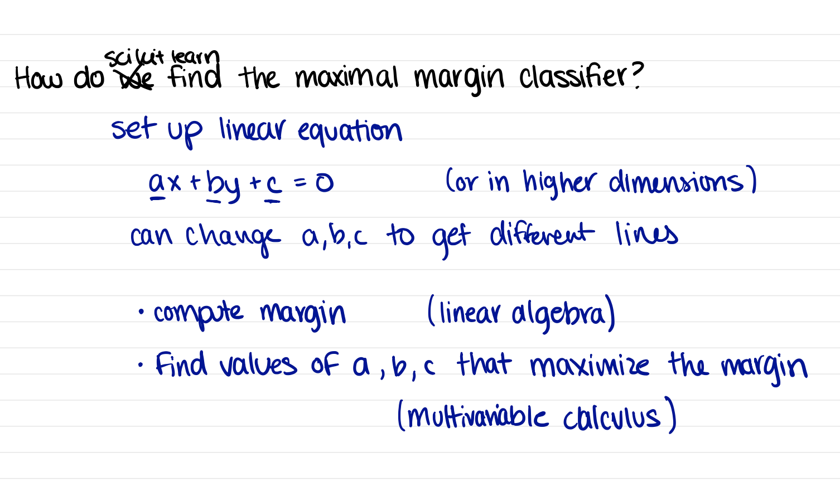
Drawbacks: need separation between the classes, only two classes, only straight line

Slide 36
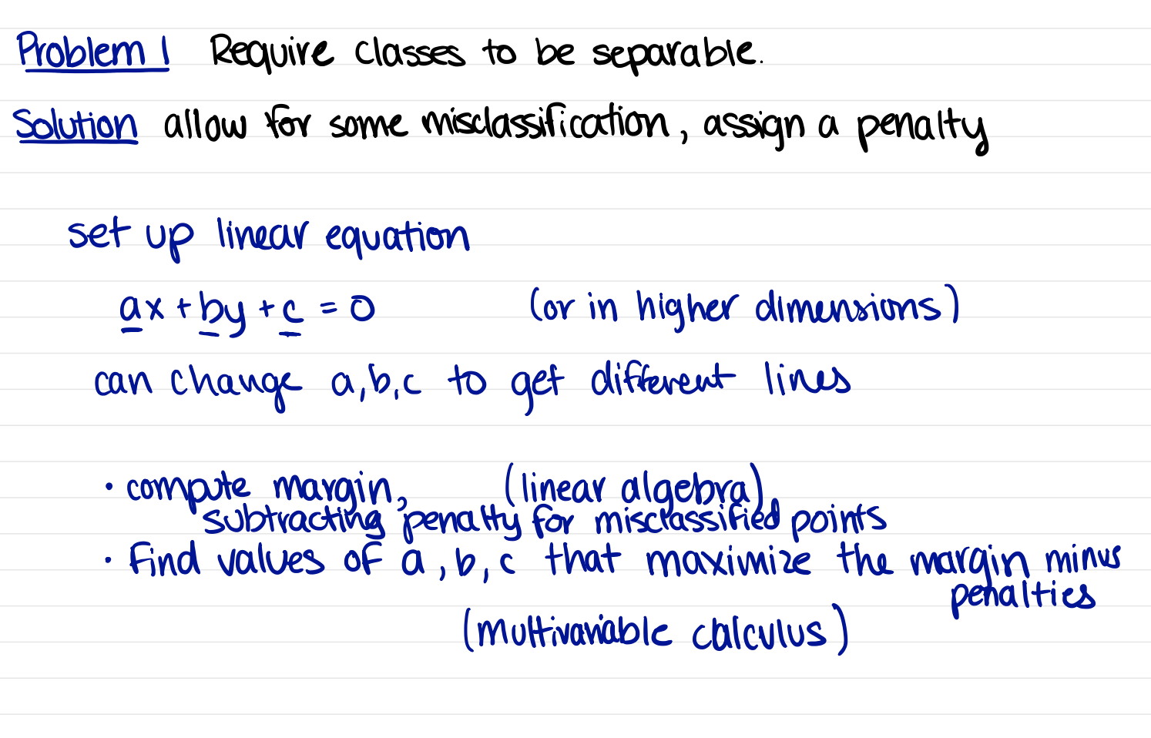

Slide 37
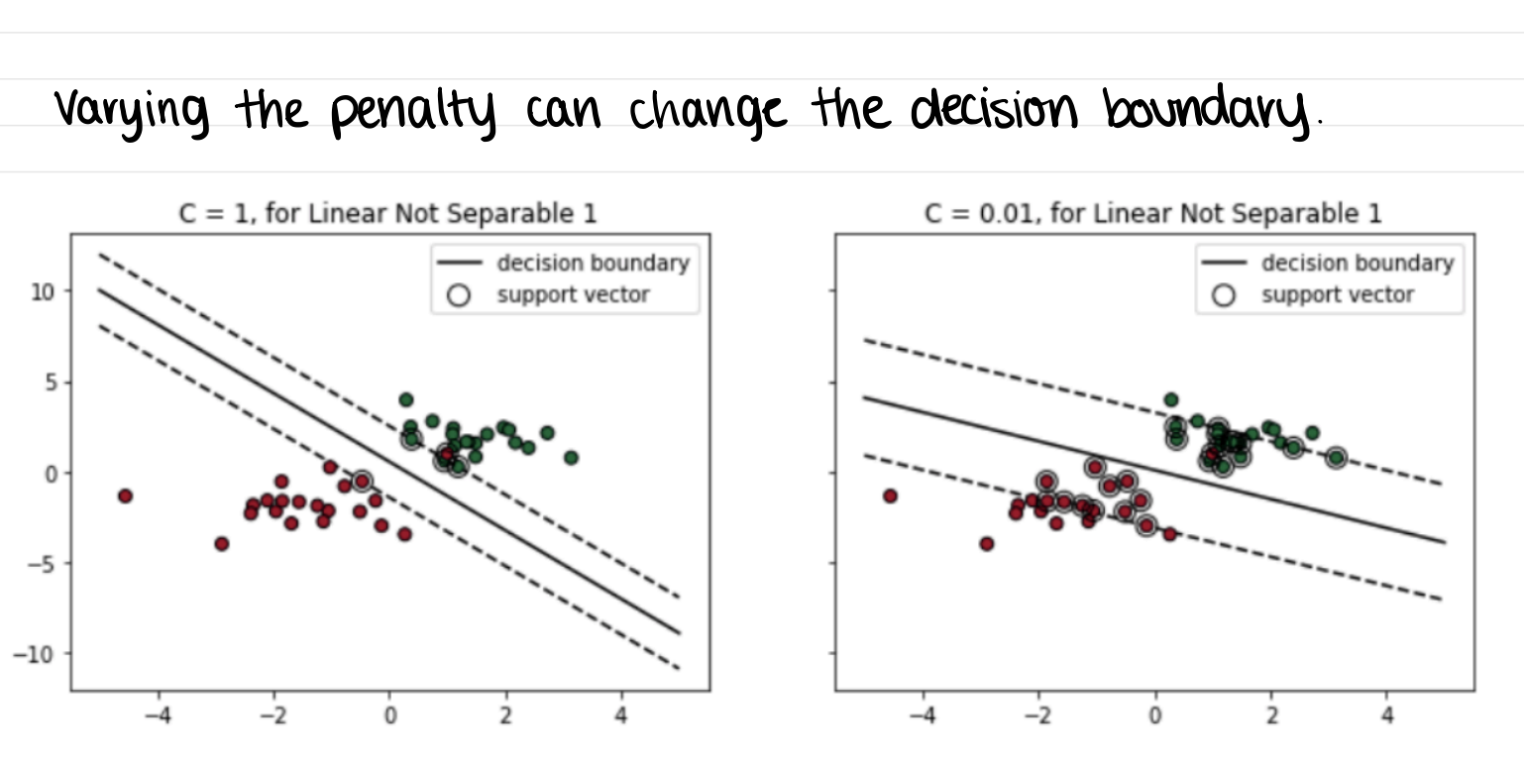

Slide 38
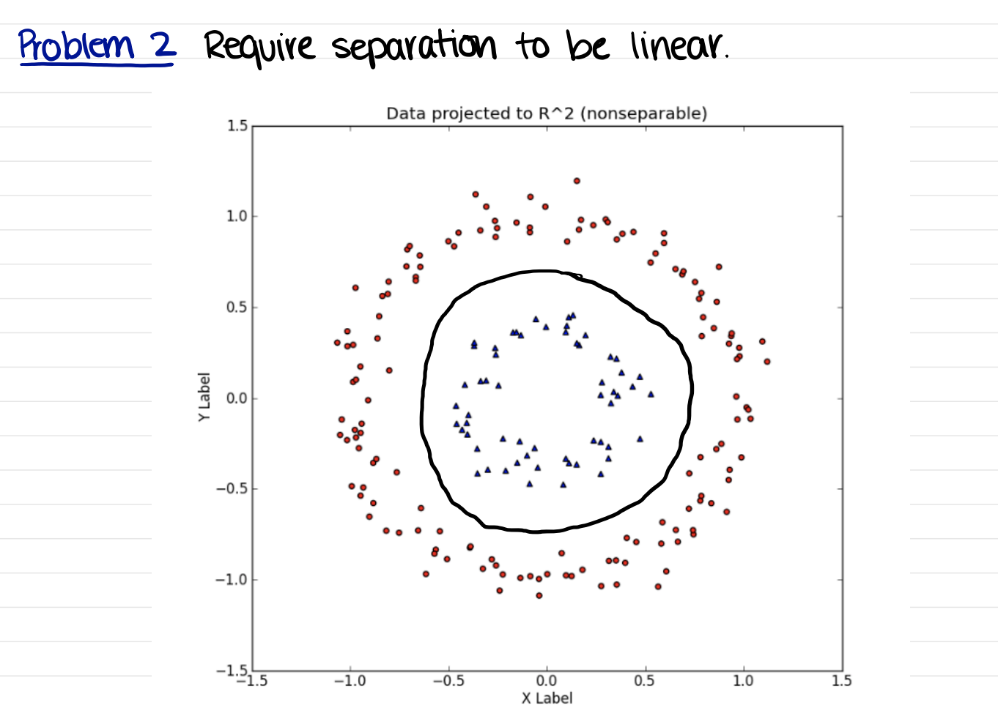

Slide 39
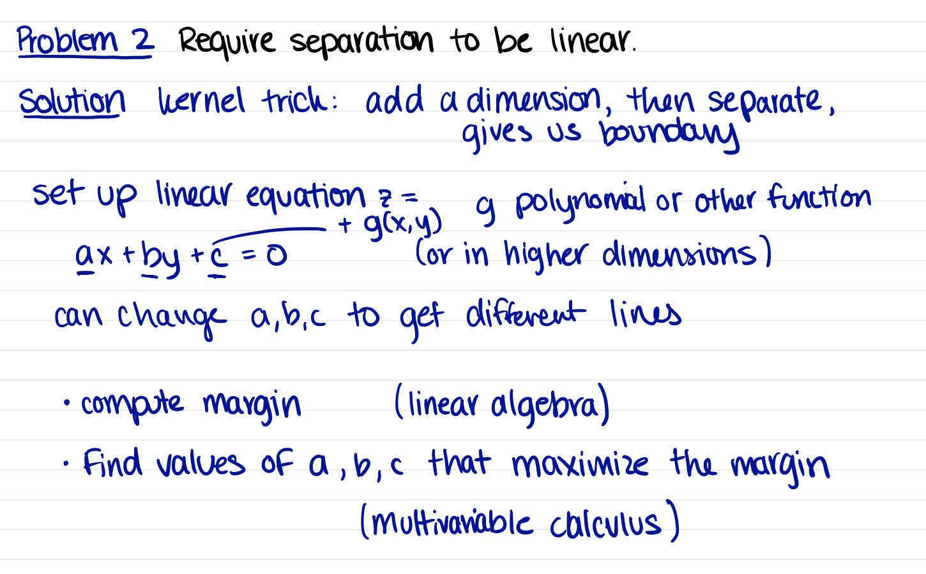

Slide 40
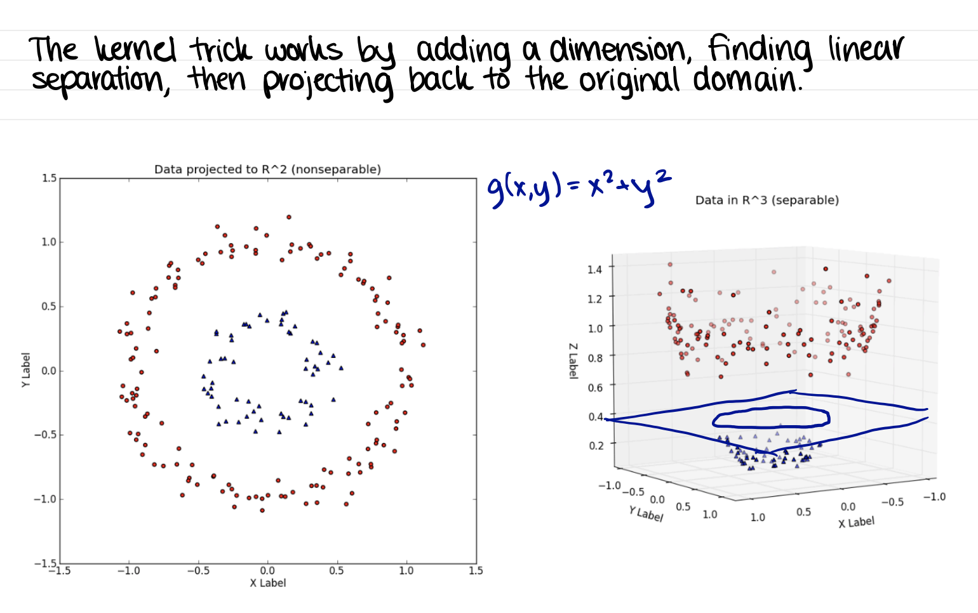

Slide 41
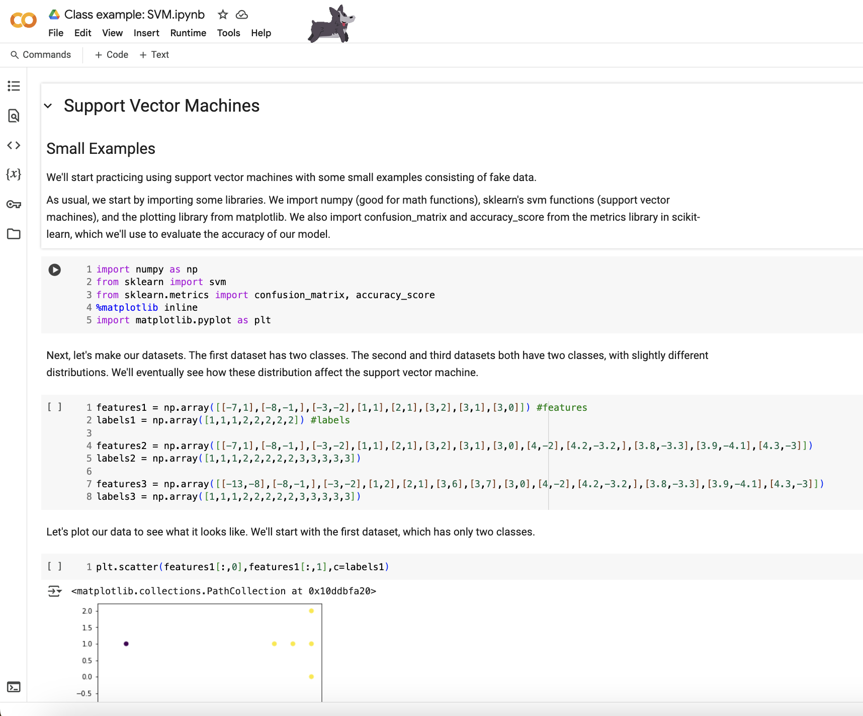
Example of how the SVM algorithm works:
click link here
Go through this to solidify your understanding.

Slide 42
How do the model’s underlying assumptions
affect applications to real-world data?
Always check which assumptions your models are using and verify if those assumptions match with the data you have.
For example, if you want to use a model that assumes i.i.d you need to verify that your data passes this check. If not, use a different modeling approach.
Model assumptions can be around statistical properties of your data (distribution, outliers, missingness), the size of your data (large, small, high-dimension, sparse), or can be simplifications (clusters need to be circular).
Assumptions can affect accuracy, speed, and explainability among other aspects.

